Slide 1
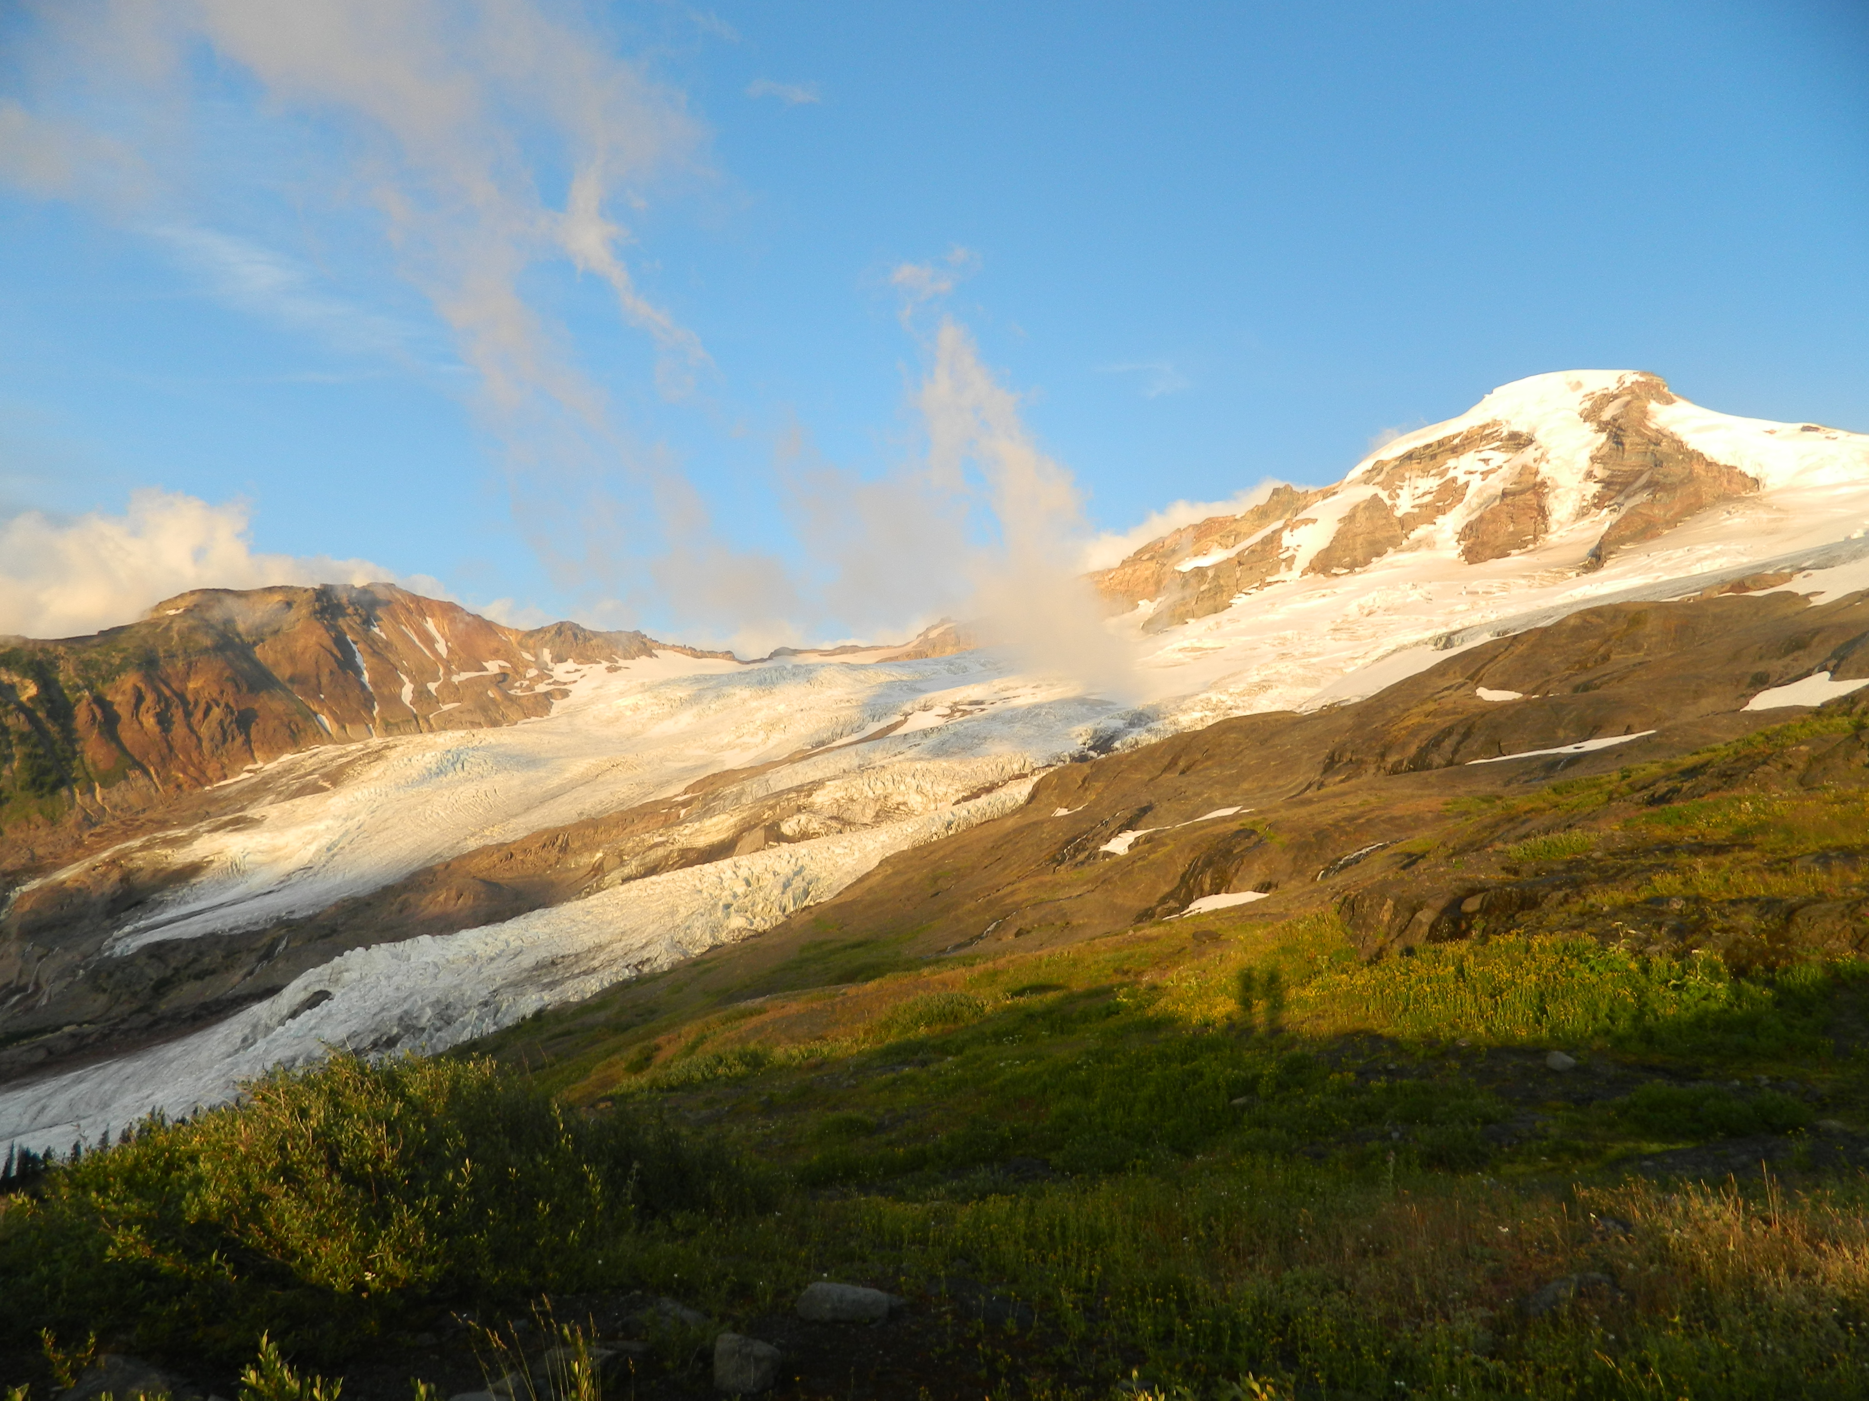
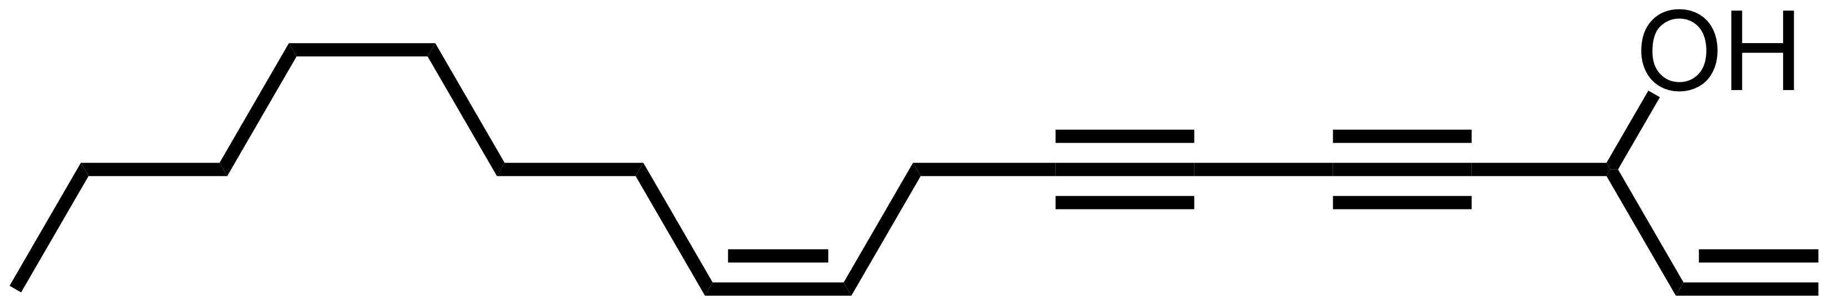
Daucus carota
falcarinol

Slide 2
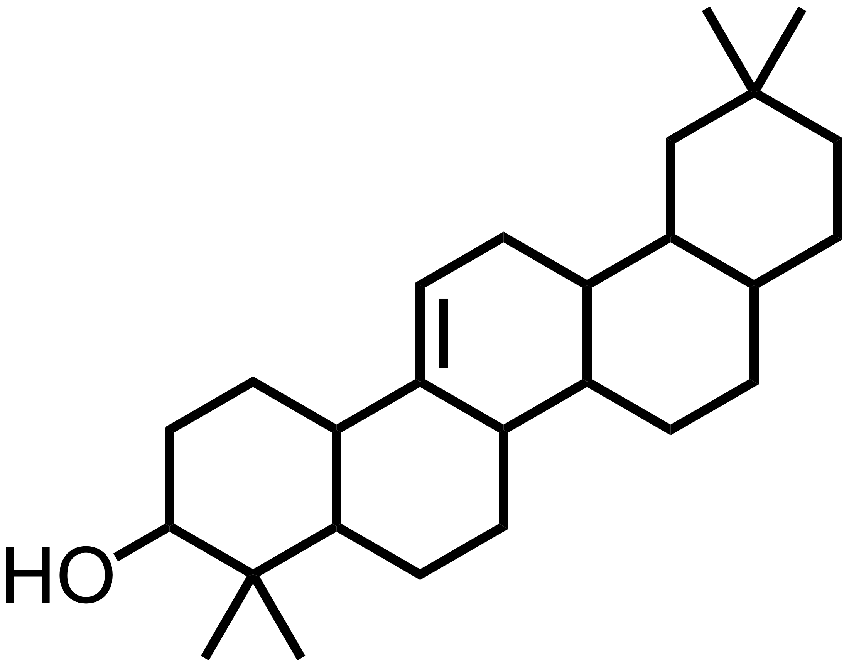
glutinol
Sorghum bicolor

Slide 3


Slide 4
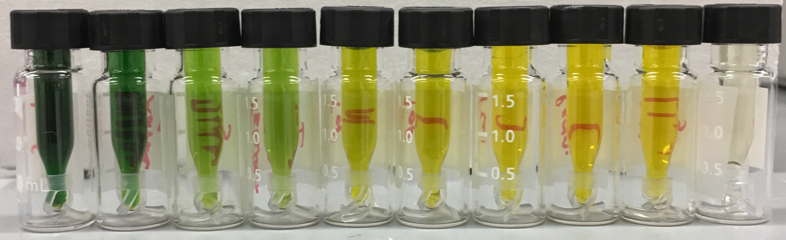
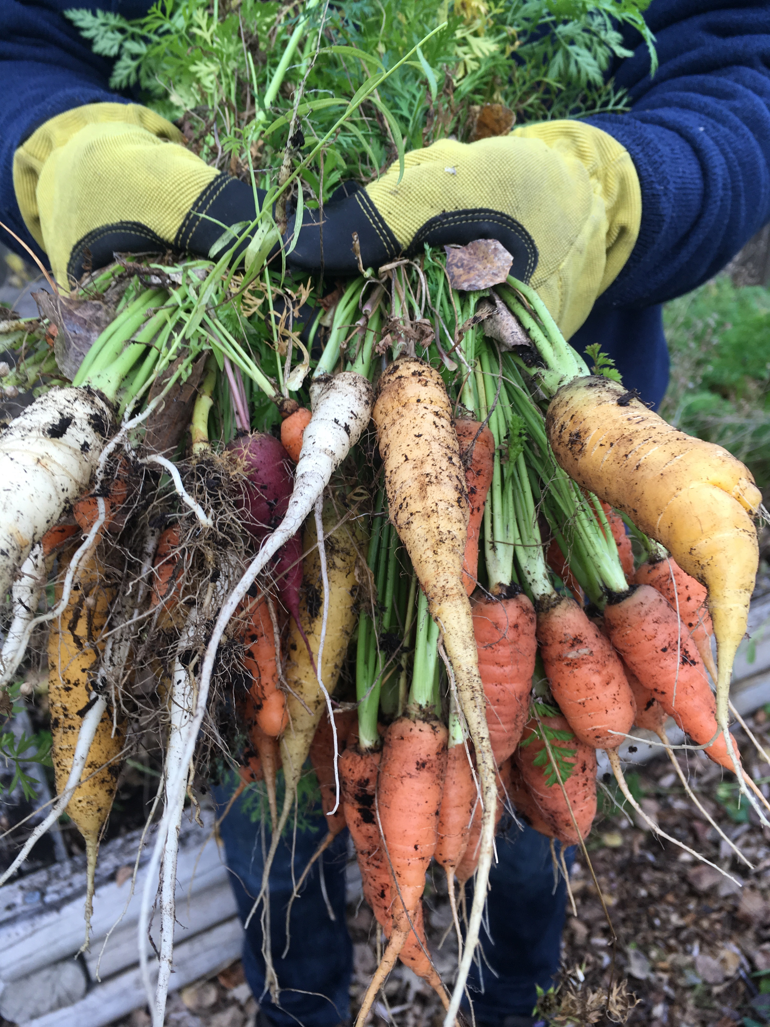
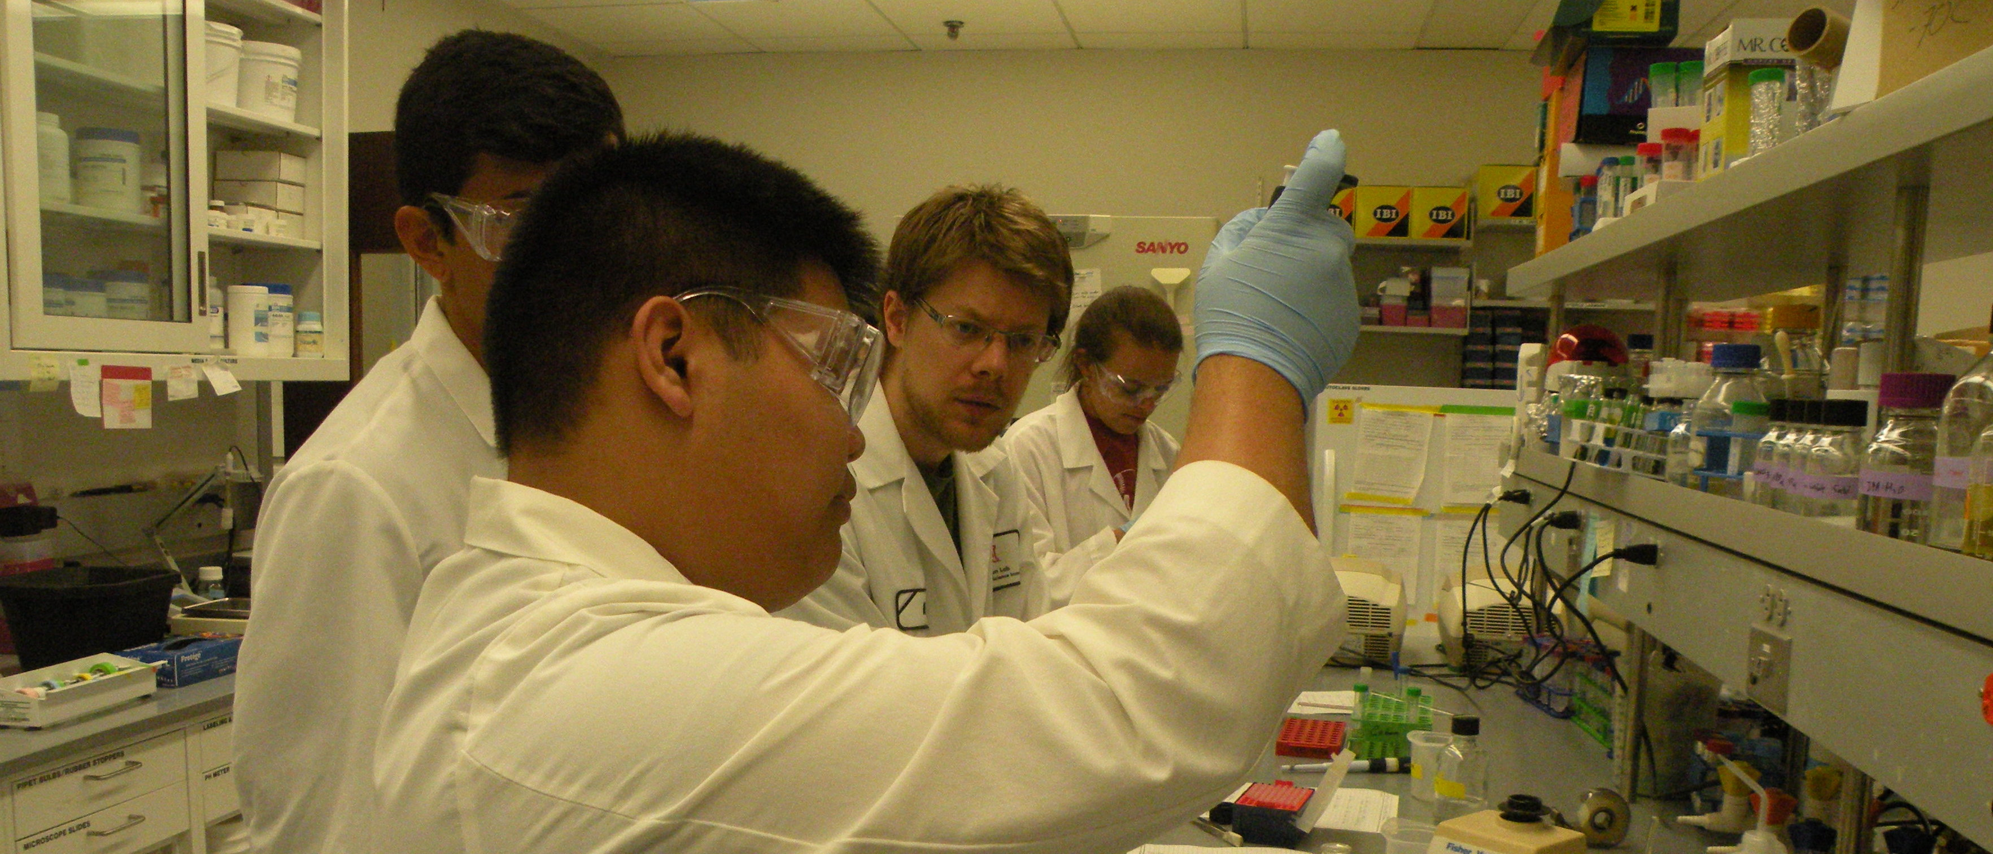
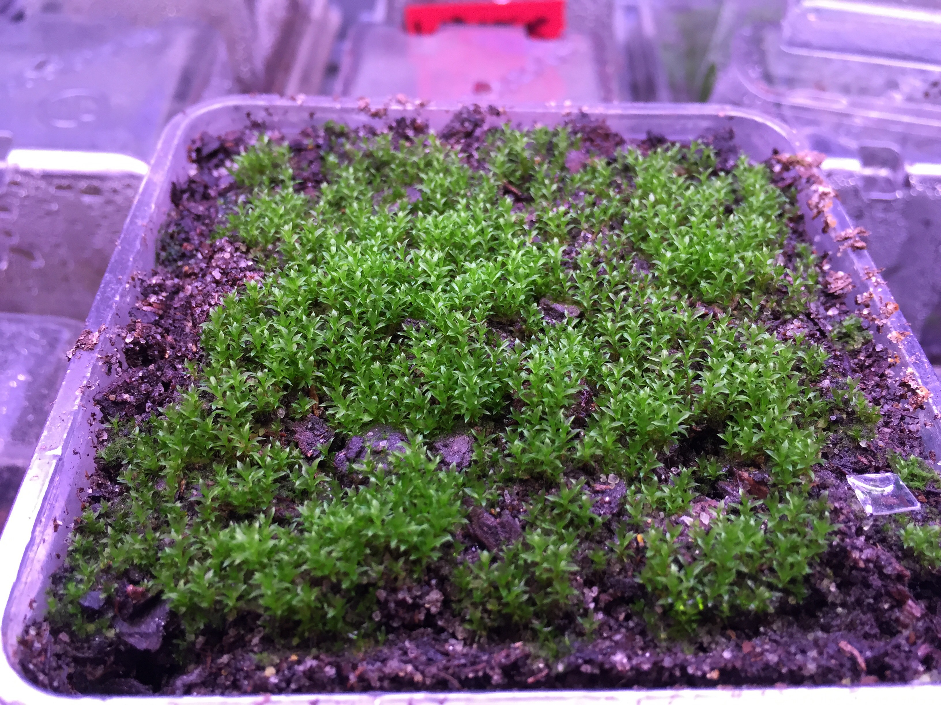
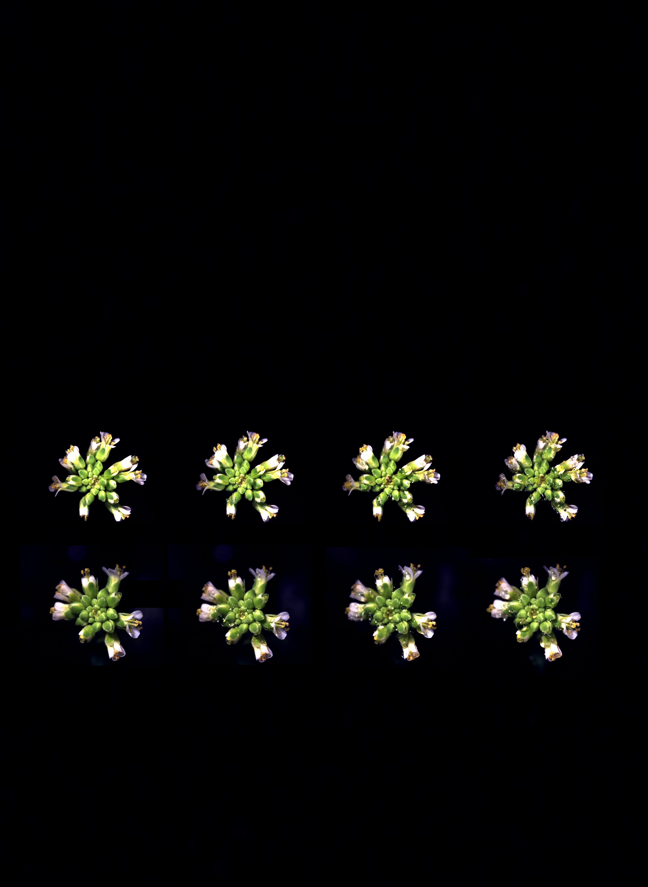
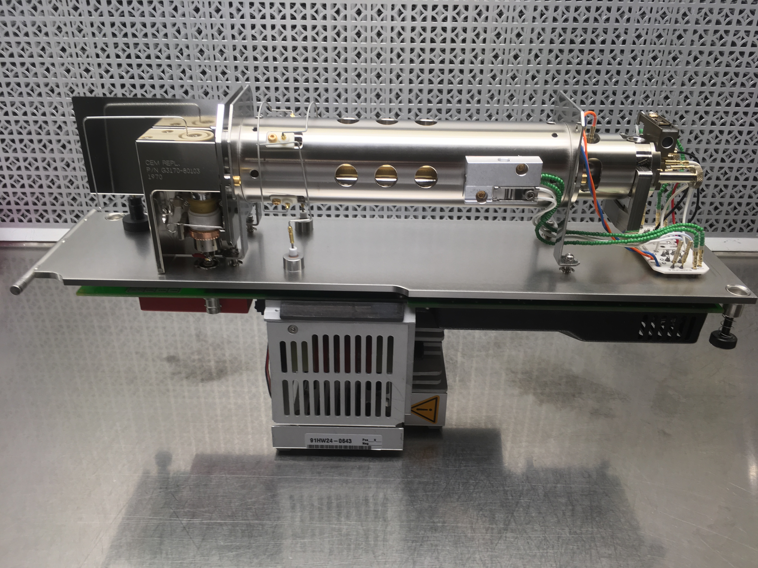
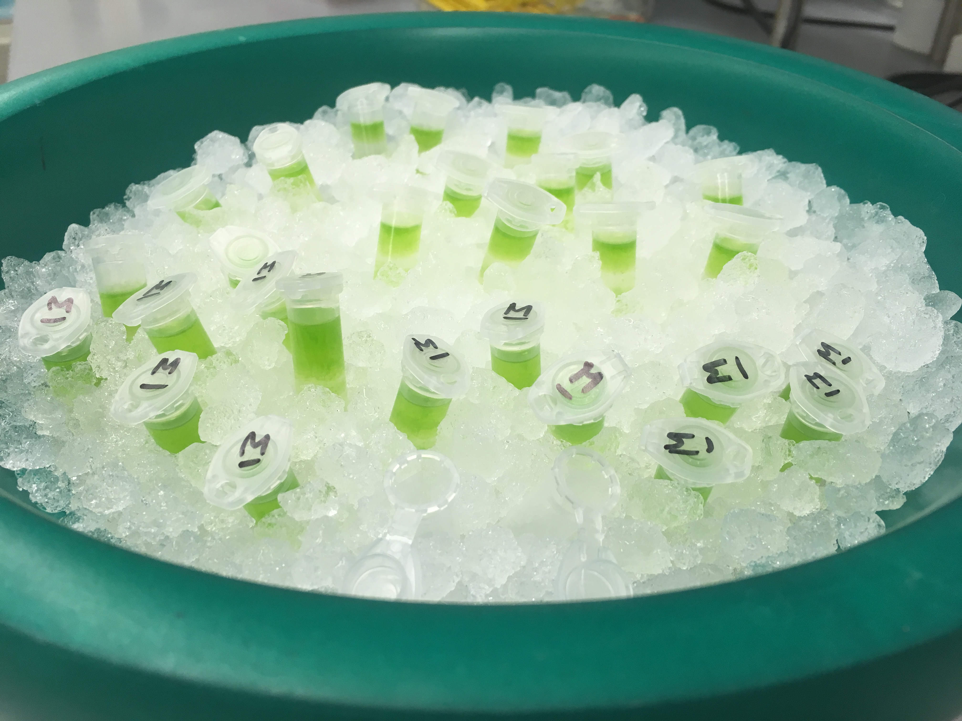
( extracts of various plant tissues ready for GC analysis. photo: collaborator E.W. LaBrant )
( harvesting carrots for a genetic diversity panel )
( working with high school students in the Cahoon lab. photo: Rebecca Cahoon )
( growing an Apiaceae diversity panel in the greenhouse )
( flowers of Arabidopsis thaliana exhibiting the lotus effect )
( moss plants, Physcomitrella patens, growing under LED lights. photo: collaborator J.M. Budke )
( cleaning and installing new parts in the mass spectrometer )
( RNA extractions from non-model species )

Slide 5
( extracts of various plant tissues ready for GC analysis. photo: collaborator E.W. LaBrant )
( harvesting carrots for a genetic diversity panel )
( working with high school students in the Cahoon lab. photo: Rebecca Cahoon )
( growing an Apiaceae diversity panel in the greenhouse )
( flowers of Arabidopsis thaliana exhibiting the lotus effect )
( moss plants, Physcomitrella patens, growing under LED lights. photo: collaborator J.M. Budke )
( RNA extractions from non-model species )

Slide 6

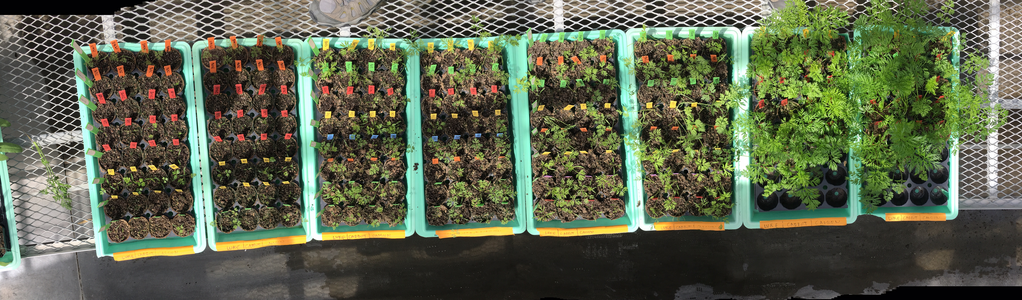
( working with high school students in the Cahoon lab. photo: Rebecca Cahoon )

Slide 7
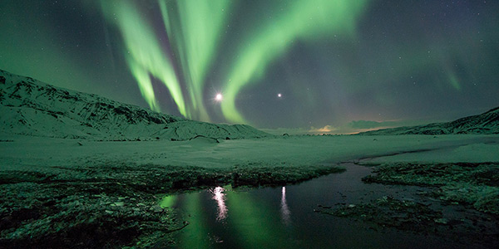
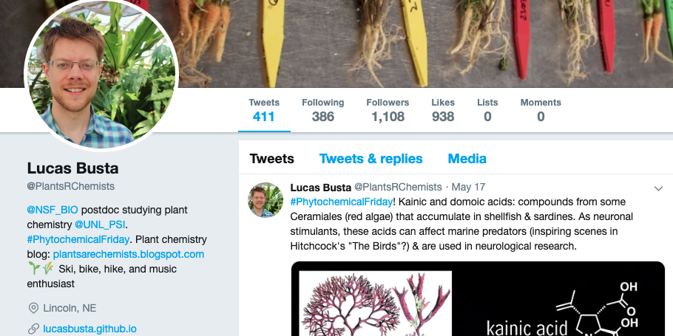

Slide 8
